Slide 1
File Handling – FILE I/O Reading and Writing Text to a File
Carole McGloughlin
Frances Sheridan

Slide 2
Worked Example
The remainder of the slides will cover the method we will use to read / write text to a file. We will cover a method for:
Writing text to a file
Reading text from a file
By text we mean normal characters, numbers, etc

Slide 3
1. Writing Text to a File
Import the correct java package. All of the packages are in the java.io package. If we don’t know the name of the class we can import the entire class.
However, it is far more efficient to import the classes we actually use.
import java.io.*;
import java.io.File;
import java.io.FileWriter;
import java.io.BufferedWriter;

Slide 4
1. Writing Text to a File
Open a file pointer. Tell Java where the file is and what it is called.
If the file is in the same directory, we simply specify the name of the file.
The file should have the file extension .txt
If the file is location elsewhere we also specify the path to the file. Note: the double \\
File f = new File (“output.txt”);
File f = new File (“C:\\myfolder\\somewhere\\output.txt”);

Slide 5
1. Writing Text to a File
Open a FileWriter object and pass the file pointer to it.
This opens a data stream to the specified file, which allows us write to the file.
FileWriter fw = new FileWriter(f);

Slide 6
1. Writing Text to a File
Open a BufferedWriter object.
This takes the FileWriter object as a parameter and writes to the file chunk at a time.
BufferedWriter bWriter = new BufferedWriter(fw);

Slide 7
1. Writing Text to a File
The actual writing is done using the write () method.
Primitive data types can be written in a similar way.
Carriage returns and line feeds can be written using:
After we have finished writing using the close() method, we close the file stream.
bWriter.write(“Line of text to be written to the file”);
String line = “Print this”;
bWriter.write(line);
bWriter.write(“\r”); // Write a carraige return to the file
bWriter.write(“\n”); // Write a line feed to the file
bWriter.close();

Slide 8
What if the File is corrupted or does not exist?
In the case of Writing to a file, if the file does not already exist, Java will create it for you.
However, the file could get corrupted or not be writable for some reason.
We always try to write to a file, but have a clause in case something goes wrong. This is known as a try-catch.
All our File IO code is surround by a try{ }
This is following by catch(IOException e){ }
IOException is a class that watches for problems associated to reading / writing to a file.
We normally print out the exception that is caught and print our own meaningful message.

Slide 9
try-catch
try{ File f = new File (“output.txt”);
FileWriter fw = new FileWriter(f);
BufferedWriter bWriter = new BufferedWriter(fw);
bWriter.write(“Writing to file”);
bWriter.close();
} catch (IOException e){ System.out.println(e.toString());
System.out.println(“Problem writing to File”);
}

Slide 10
1. Writing Text to a File
Working with the last Employee Application, we will add an additional button to write the details stored in the object to a file.
Download the EmployeeArrayList.zip from Moodle. Unzip it and rename to EmployeeFileIOApp
Open up the project in netbeans
Right click on the project name, and rename to EmployeeFileIOApp
Expand the source Packages and refractor and rename the package to employeefileio
Right click on the Project name and go to Properties, in the Run category make sure the main class is correct.
You may need to amend the package name.

Slide 11
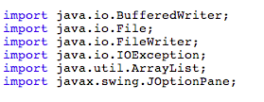
EmployeeGUI.java
Open EmployeeGUI.java
In the design palette add a new button, rename to writeJB and edit so it reads Write to File
Double click the button to create a new actionPerformed method.
We want to write all data that is stored in our array of objects to this file.
First set up the File objects
You will notice they are all underlined in red
Right click on each, and select Fix imports
This should be surrounded in a try - catch

Slide 12
writeJBActionPerformed
Loop around the ArrayList of objects, pop each object from the array list
Check to see what type of Employee it is
Write the relevant details to the files, separated by a comma
For example, for a basic employee, Frank with employee id number 101, we would write:
Employee, Frank , 101

Slide 13
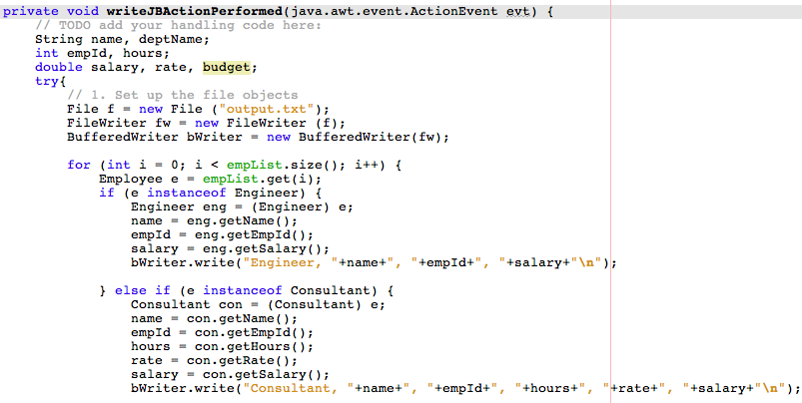
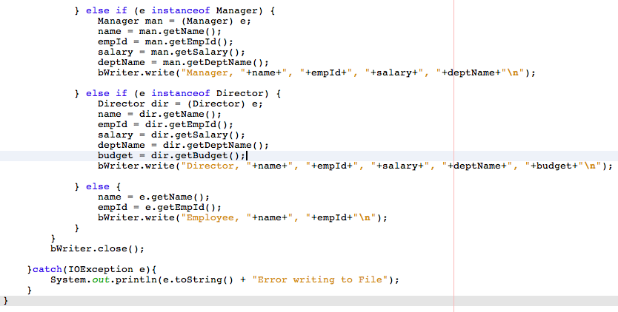

Slide 14
2. Reading Text from a File
Import the correct java package. All of the packages are in the java.io package. If we don’t know the name of the class we can import the entire class.
However, it is far more efficient to import the classes we actually use.
import java.io.*;
import java.io.File;
import java.io.FileReader;
import java.io.BufferedReader;

Slide 15
2. Reading Text from a File
Open a file pointer. Tell Java where the file is and what it is called.
If the file is in the same directory, we simply specify the name of the file.
The file should have the file extension .txt
If the file is location elsewhere we also specify the path to the file. Note: the double \\
File f = new File (“input.txt”);
File f = new File (“C:\\myfolder\\somewhere\\output.txt”);

Slide 16
2. Reading Text from a File
Open a FileReader object and pass the file pointer to it.
This opens a data stream to the specified file, which allows us write to the file.
FileReader fr = new FileReader (f);

Slide 17
2. Reading Text from a File
Open a BufferedReader object.
This takes the FileReader object as a parameter and writes to the file chunk at a time.
BufferedReader bReader = new BufferedReader(fr);

Slide 18
2. Reading Text from a File
The actual reading is done using the readLine () method.
The method returns a String variable – to read a single line from a file:
In most cases there is more than one line to read from a file.
Often we do not know how many lines there are so we use a loop, testing for the line to be null (or end of file)
String line;
line = bReader.readLine();
String line;
line = bReader.readLine();
while (line != null){ line = bReader.readLine();
}

Slide 19
2. Reading Text from a File
After we have finished writing using the close() method, we close the file stream.
bReader.close();

Slide 20
What if the File is corrupted or does not exist?
If the File does not exist or is corrupted, we can’t read from it.
Again, we always try to read from a file, but have a clause in case something goes wrong – we use a try – catch
All our File IO code is surround by a try{ } which is followed by catch(IOException e){ }
try{ File f = new File (“input.txt”);
FileReader fr = new FileReader (f);
BufferedReader bReader = new BufferedReader (fr);
String line = bReader.readLine();
while (line != null) { line = bReader.readline();
}
bWriter.close();
} catch (IOException e){ System.out.println(e.toString());
System.out.println(“Problem writing to File”);
}

Slide 21
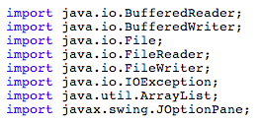
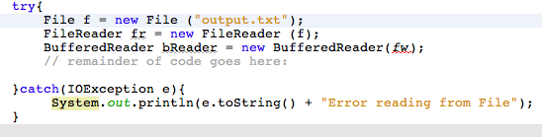
2. Reading Text from a File
Continuing with the EmployeeFileIOApp example.
Back in the Design palette add another new button, change variable name to loadJB and label it Load File
Double click the button to create a new actionPerformed method.
We want to read all data that is stored in our file and populate an array of objects.
First set up the File objects and Fix imports

Slide 22


2. Reading Text from a File
Since we wrote the data to the file separated by commas, we can split the string read in on commas.
The first item in the array arr is the type of Employee. Check to see what type of employee it is.
And add the details to the array lists, parsing the strings to ints or double where needed.
Do this for each type of Employee
Check to see what type Employee
Create a new Employee object, add details using constructor
Add object to ArrayList empList

Slide 23
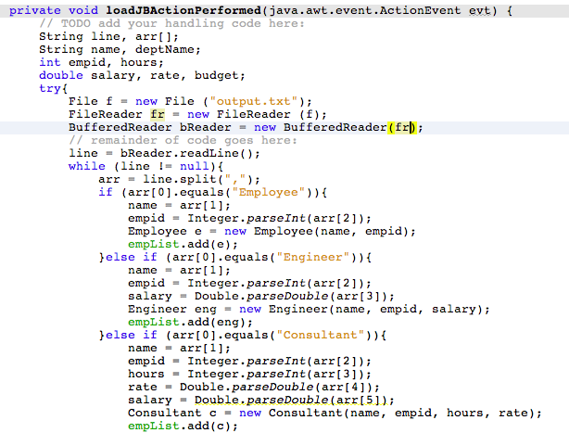
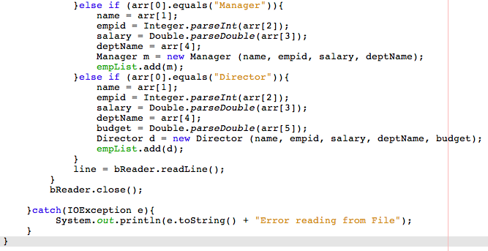

Slide 24
Notification of Successful I/O
Its worth adding some kind of print statement or message to show successful completion of File I/O.
For both read and write, a JOptionPane stating successful attempt completed was added to the actionPerformed methods.
For example,
JOptionPane.showMessageDialog(null, "Success reading from File: "+f);

